Slide 1
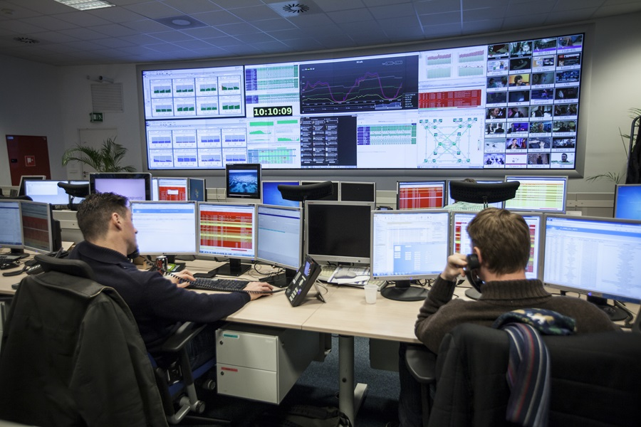

Slide 2
Telecommunication CDR (Call Detail Record) Analysis
Rutgers University
Python Methodologies for Data Science
Team 4
Hung-Yueh Chang
Oludare Bello
Shih-Yen Lin

Slide 3
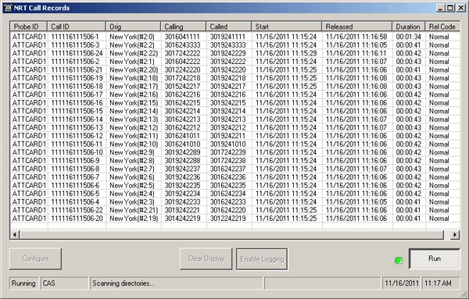
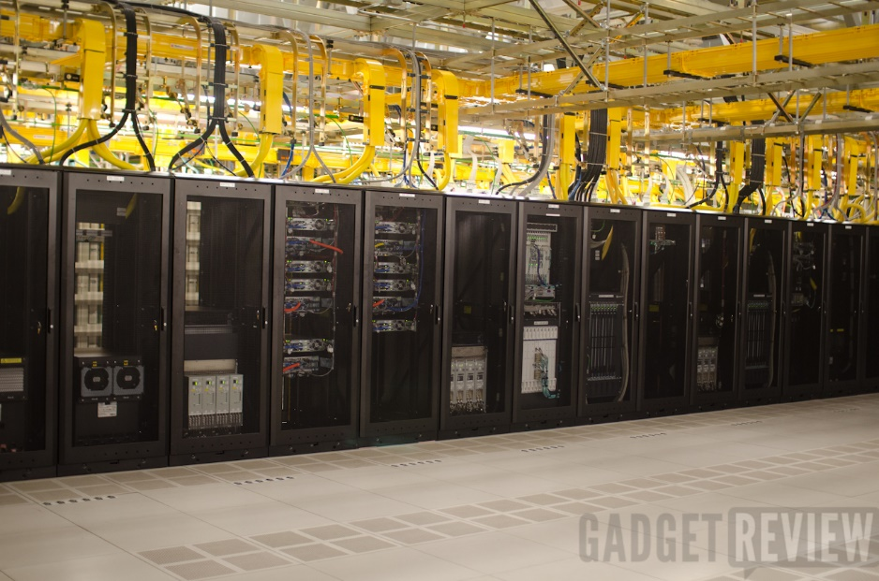
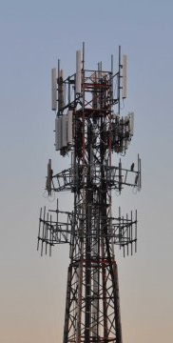
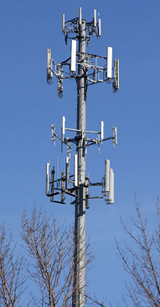


NETWORK OPERATION CENTER
NETWORK REPAIR BEAREAU
NETWORK CHANGE AND CONF GROUP
TOP BUSNESS MANAGEMENT
Call Data Record

Slide 4
Program files
input.csv (Formatted Dummy Call Data Record retrieved from http://www.ilterismutlu.com/. )
CDRLib.py - a customized Library for CDR analysis
File i/o Function and Class
Third Party Libraries matplolib
CDR PROGRAM:-a integrated program including our analysis.
Other FILES
Power point presentation
Documentation
Demo Video

Slide 5
Explanation of CDR RECORD
input.csv (Formatted Dummy Call Data Record retrieved from http://www.ilterismutlu.com/.
Call Data Record consist of:
CALLER: It’s a number with 10 digitals. It means that “This number started the call”. This is also known as the call source/originator
CALLED: It’s a number with 10 digitals. The Call Reviver
CALL_TIME: The exact time when originator initiated the call to the Receiver
CONNECTION_TIME: This is time that the call was connected to receiver
CONNECTION_FINISH_TIME: This is the time the call between Originator and Receiver ended.
CALL_DURATION_SEC: Connection Finish time - Connection Time
FINISH_REASON: “NETWORK_ERROR” “NOT_REACHED” “HANG_UP” and “BUSY”.
COST: The fee charged to the customer (Originator) for the call service rendered

Slide 6
Explanation of cdrlIB.PY
CDRLib.py - a customized Library for CDR analysis
File i/o Function - Read CSV File , navigate through list and remove unwanted heading row
Call Class
Getter for each of the needed variables {CALLER,CALLED,CALL_TIME,CONNECTION_TIME, *Time Zone(Day, Evening, Nights, CALL_DURATION_SEC,FINISH_REASON,COST}
Helper function that would be used to recall a class "call()"
Four(4) analysis defined by functions
# Network error rate % function {errorcounter/total}
# Network error analysis by timezone *file output
Call reason analysis by timezone * matplotlib
Call time and cost analysis in different days * matplotlib
Third Party Libraries matplotlib
Using the pyplot to plot pie graph

Slide 7
Explanation of cdr Program
CDR PROGRAM:-Integrated program
File i/o – input file
Helper func to recall a class "call()"
Analysis option for users
A – Network Error
B – Network Error By TimeZone
C – Call Time Analysis by TimeZone
D – Call Time and Cost Analysis by day of the week
Decision to continue or end

Slide 8
Results from analysis
The amount and ratio of Network ERROR analysis
NETWORKERROR
analysis
by
TIMEZONE
The amount of NETWORK_ERROR calls are 88.
Total calls are 1000.
NETWORK_ERROR rate is 8.8%
This is NETWORKERROR analysis by TIMEZONE
Print out on screen or output a file (s/f): s
##NETWORK_ERROR Table##
Time_zone Counts Rate
Day 32 3.2%
Evening 34 3.4%
Night 22 2.2%
keep analyzing (y/n): y
Please choose one: (A/B/C/D)?B
This is NETWORKERROR analysis by TIMEZONE
Print out on screen or output a file (s/f): f
Input a file name:team4
NETWORK EFFICIENCY IS KEY
TO RETAINING YOUR CUSTOMERS

Slide 9
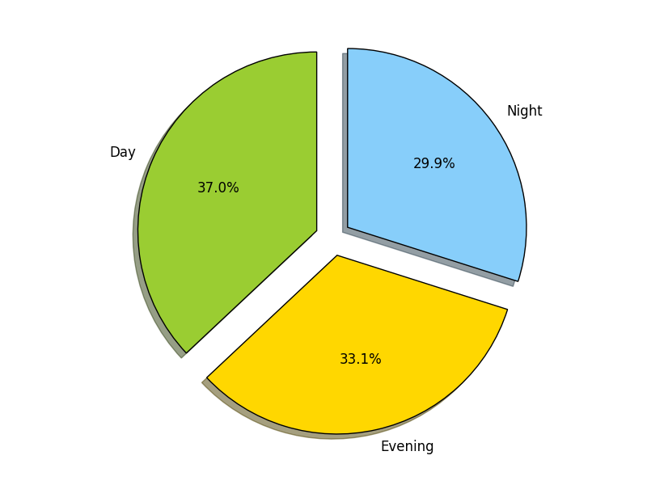
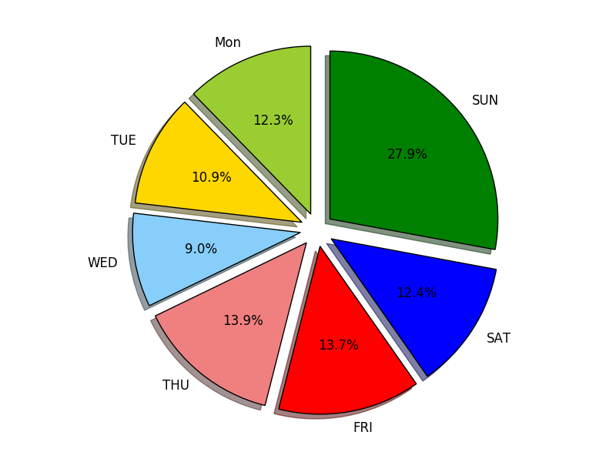
Results from analysis
Call reason analysis by timezone
There are 370 day time calls
There are 331 evening time calls
There are 299 night time calls
Call time and cost analysis in different days
MON time 27390.0; SEC cost: 11777.70; per sec0.43000000000000005
TUE time 24181.0; SEC cost: 10397.83; per sec0.43000000000000016
WED time 20083.0; SEC cost: 8635.69; per sec0.43000000000000005
THU time 30864.0; SEC cost: 13271.52; per sec0.43
FRI time 30467.0; SEC cost: 13100.81; per sec0.4300000000000001
SAT time 27537.0; SEC cost: 11840.91; per sec0.42999999999999994
SUN time 62167.0; SEC cost: 26731.81; per sec0.42999999999999994

Slide 10








THANK YOU

